Slide 1
Status Report
2015. 11. 16
Nam Jong Woo

Slide 2
Action Item
Diuon plots applying all selections
Dimuon pT, eta, invariant mass
Include Ratio plot
M60to120

Slide 3
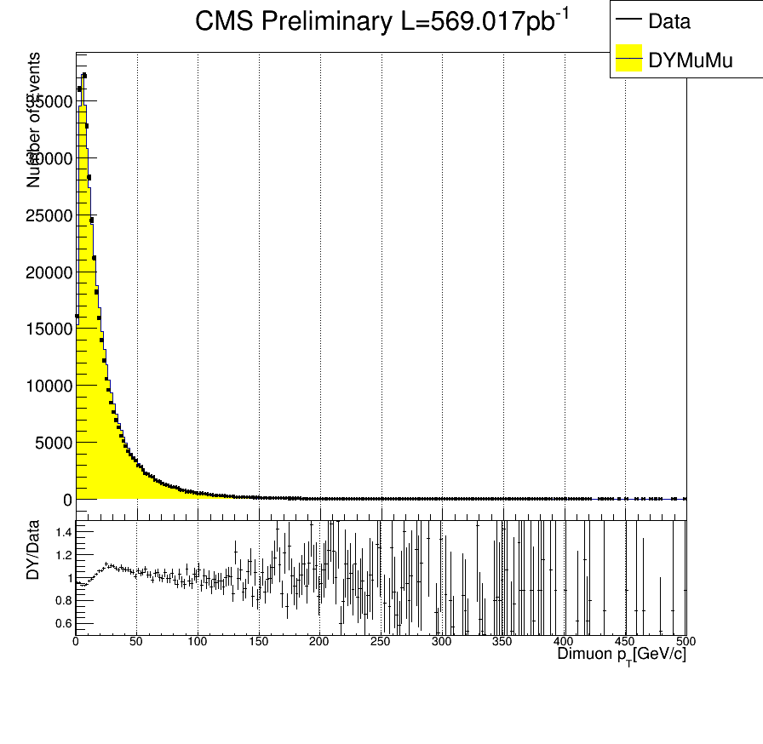
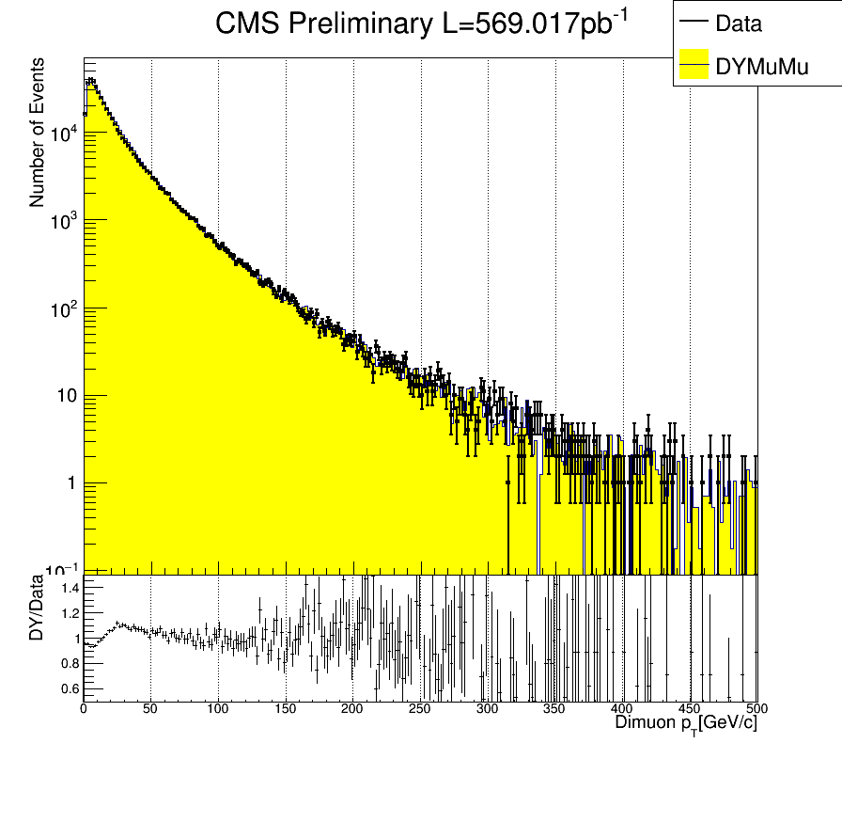
Dimuon Pt

Slide 4
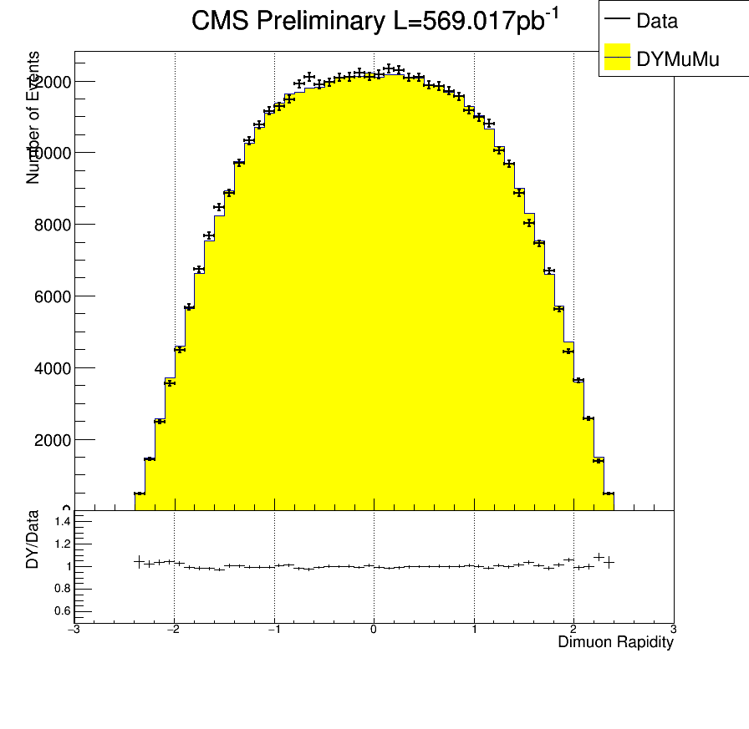
Dimuon Rapidity

Slide 5
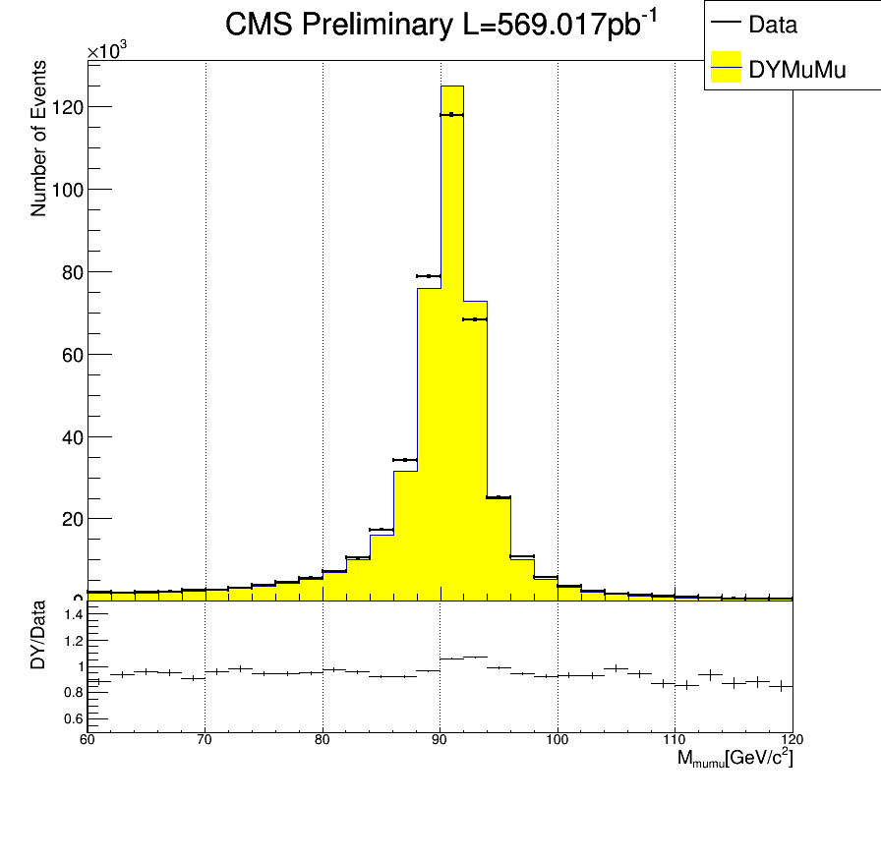
Dimuon Invariant mass

